Slide 1
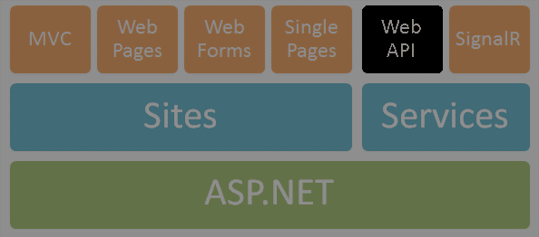
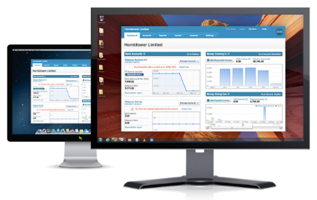




ASP.NET Web API
Web Services and Cloud
Telerik Software Academy
http://academy.telerik.com

Slide 2


Table of Contents
The HTTP Protocol
What is ASP.NET Web API?
Web API Features
Demo: Default Project Template
Web API Controllers
Controllers
Demo: Create API Controller
Web API Clients
Demo: Consuming Web API

Slide 3


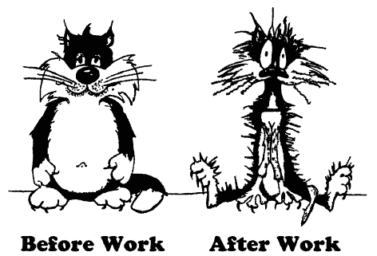
The HTTP Protocol
How HTTP Works?
HTTP

Slide 4
HTTP
Hyper Text Transfer Protocol (HTTP)
Client-server protocol for transferring Web resources (HTML files, images, styles, etc.)
Important properties of HTTP
Request-response model
Text-based format
Relies on a unique resource URLs
Provides resource metadata (e.g. encoding)
Stateless (cookies can overcome this)

Slide 5
HTTP: Request-Response Protocol
Client program
Running on end host
E.g. Web browser
Requests a resource
Server program
Running at the server
E.g. Web server
Provides resources
GET /index.html
HTTP/1.0
HTTP/1.0 200 OK
"Welcome to our
Web site!"
5

Slide 6
HTTP Request Message
Request message sent by a client consists of
Request line – request method (GET, POST, HEAD, ...), resource URI, and protocol version
Request headers – additional parameters
Body – optional data
E.g. posted form data, files, etc.
<request method> <resource> HTTP/<version>
<headers>
<empty line>
<body>

Slide 7
HTTP Response Message
Response message sent by the server
Status line – protocol version, status code, status phrase
Response headers – provide meta data
Body – the contents of the response (the requested resource)
HTTP/<version> <status code> <status text>
<headers>
<CRLF>
<response body – the requested resource>

Slide 8
HTTP Response Codes
HTTP response code classes
1xx: informational (e.g., “100 Continue”)
2xx: success (e.g., “200 OK”)
3xx: redirection (e.g., “304 Not Modified”, "302 Found")
4xx: client error (e.g., “404 Not Found”)
5xx: server error (e.g., “503 Service Unavailable”)
"302 Found" is used for redirecting the Web browser to another URL

Slide 9

Demo: Postman
Chrome App: Postman

Slide 10

What is ASP.NET Web API?

Slide 11
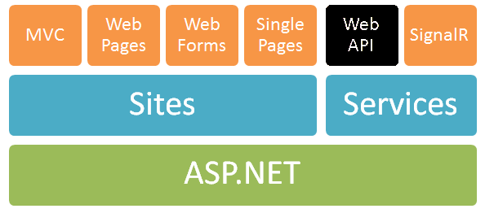
ASP.NET Web API
Framework that makes it easy to build HTTP services for browsers and mobile devices
Platform for building RESTful applications on the .NET Framework using ASP.NET stack

Slide 12



ASP.NET Web API Role
Data storage
XML
HTTP GET
JSON
Data Layer (EF)
ASP.NET Web API
Models
JSON
XML
HTTP PUT, POST, DELETE

Slide 13
Web API Features
Modern HTTP programming model
Access to strongly typed HTTP object model
HttpClient API – same programming model
Content negotiation
Client and server work together to determine the right format for data
Provide default support for JSON, XML and Form URL-encoded formats
We can add own formats and change content negotiation strategy

Slide 14
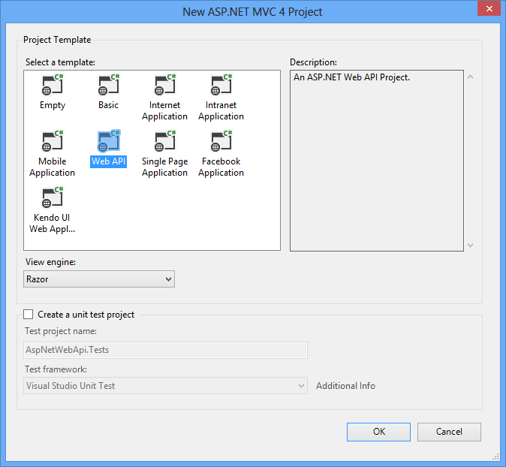
Demo: Creating ASP.NET Core Web API Project
Default ASP.NET Web API project template

Slide 15

Web API Controllers

Slide 16
ApiControllers
The core component
All the controllers should be available in a folder by name Controllers
Controller naming standard should be "nameController" (convention)
Every controller should inherit ControllerBase class
Routers instantiate controllers in every request
All requests are mapped to a specific action

Slide 17
Actions
Actions are the ultimate request destination
Public controller methods
Non-static
Actions typically return an IActionResult
public ActionResult<Product> Get(int id)
{
if (!_repository.TryGetProduct(id, out var product))
{
return Ok(product);
} else
{
return NotFound();
} }

Slide 18
Web API Controllers
A controller is an object that handles HTTP requests
All API controllers derive from ControllerBase
By default ASP.NET Core Web API will map HTTP requests to specific methods called actions
Action | HTTP method | Relative URI | Method
Get a list of all posts | GET | /api/posts | Get()
Get a post by ID | GET | /api/posts/id | Get(int id)
Create a new post | POST | /api/posts | Post(PostModel value)
Update a post | PUT | /api/posts/id | Put(int id, PostModel value)
Delete a post | DELETE | /api/posts/id | Delete(int id)
Get a post by category | GET | /api/posts?category=category | Get(string category)

Slide 19
Web API Default Behavior
1
2
3
Web Request
Match a Route
API Controller Responds
http://localhost:1337/api/posts
HTTP GET Request
Controller Name
public class PostsController : ControllerBase
{
public string Get()
{
return "Some data"; }
}

Slide 20
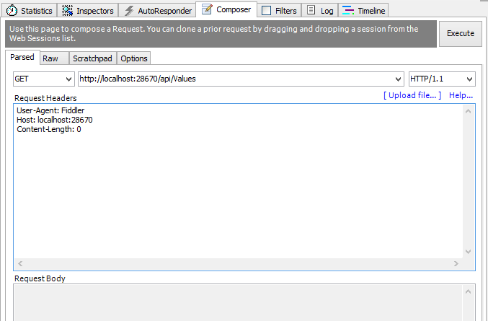
Demo: Create API Controller

Slide 21

Web API Clients

Slide 22
HttpClient Model
HttpClient is a modern HTTP client for .NET
Flexible and extensible API for accessing HTTP
Has the same programming model as the ASP.NET Web API server side
HttpRequestMessage / HttpResponseMessage

Slide 23
Demo: Consume Web API from Console Application

Slide 24
Consuming Web API from JS
Web APIs can be consumed using JavaScript via HTTP AJAX request
Example with jQuery:
<ol id="posts"></ol>
<script>
$.ajax({
url: '/api/posts',
success: function (posts) {
var list = $('#posts');
for (var i = 0; i < posts.length; i++) {
var post = posts[i];
list.append('<li>' + post.title + '</li>');
}
}
});
</script>
Should be encoded

Slide 25
ASP.NET Web API
http://academy.telerik.com

